Slide 1

Multi Camera Tracking Project
Spring 2025 – Biweekly progress

Slide 2
Agenda
Objective
Recap
Current progress
Dataset description
Results
Conclusion
Next steps

Slide 3
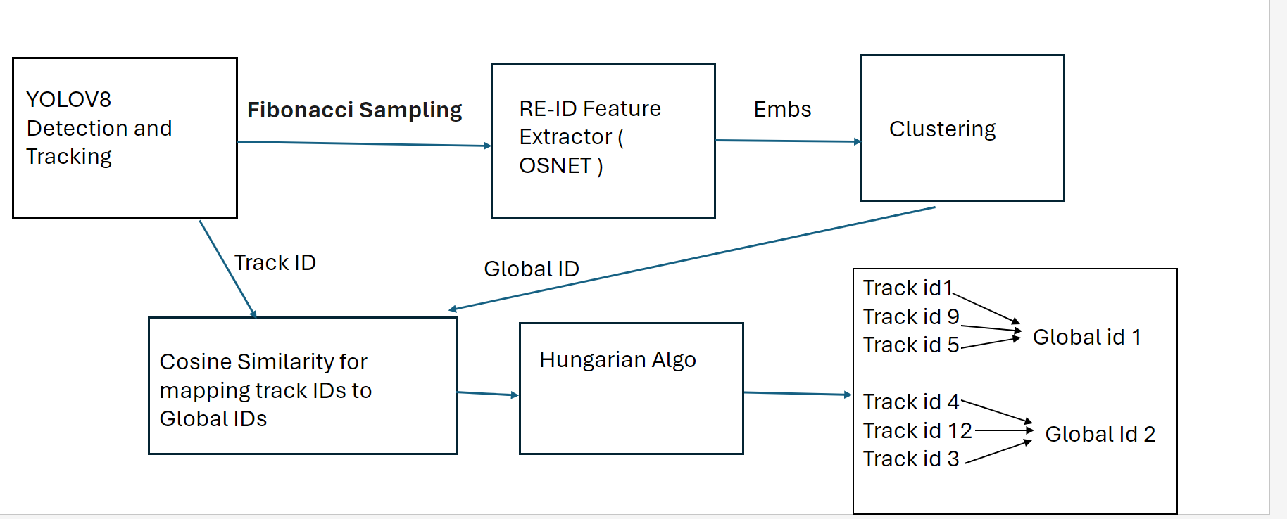
Objective
Project Goal : Developing a robust foundational Mutli camera tracking model , with a focus on person re-identification(Re-ID) tasks for this semester.

Slide 4
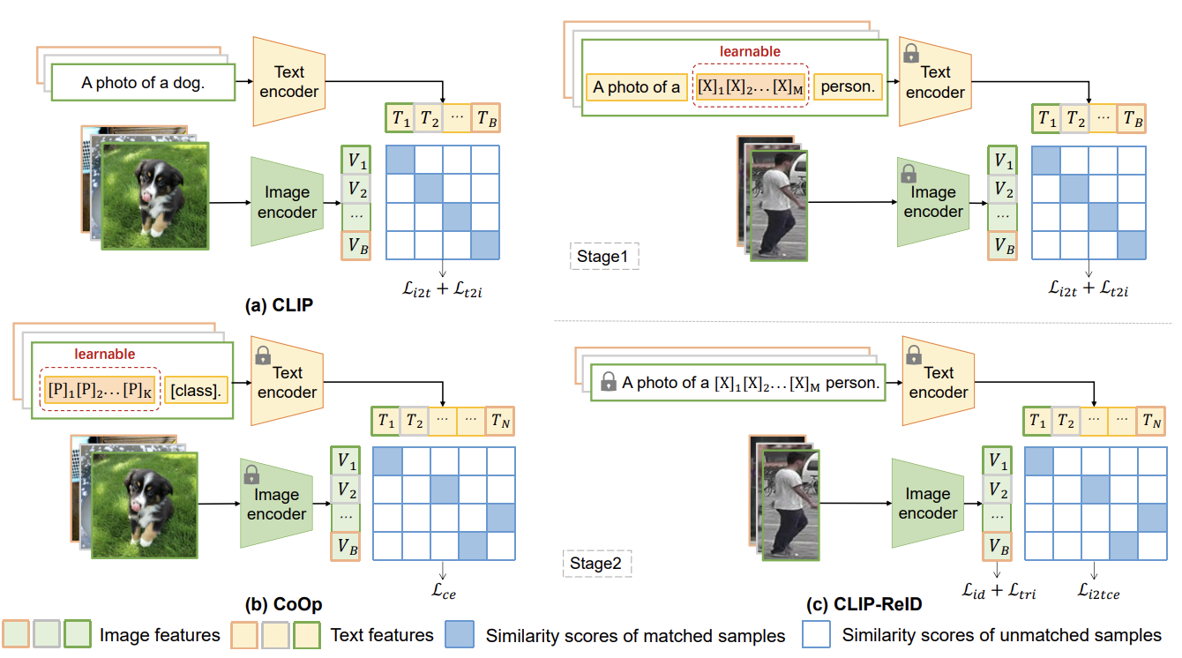
Recap – Literature Review on CLIP-ReID
Stage 1: Learnable Text Token Optimization
Fixed image and text encoders
Optimization of learnable text tokens
Contrastive loss similar to CLIP
Stage 2: Image Encoder Fine-tuning
Fixed text tokens and text encoder
Fine-tuning of image encoder
ID loss and triplet loss
Cross-modality image-to-text cross-entropy loss

Slide 5
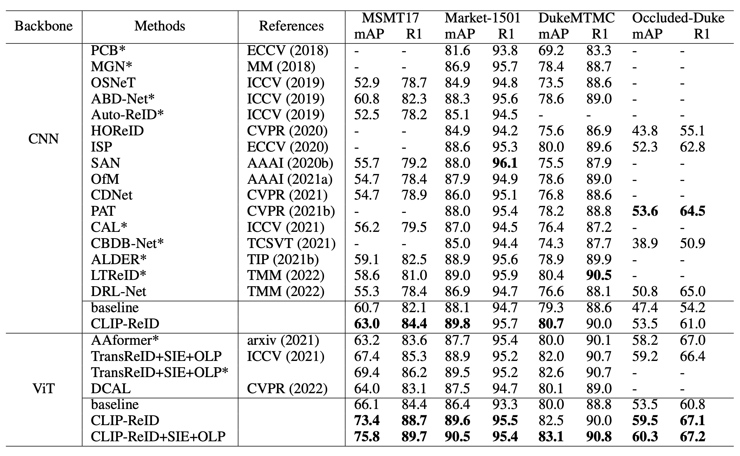
CLIP-ReID – State-of-the-art Comparison
43% in mAP
14% R1(rank1 accuracy)

Slide 6
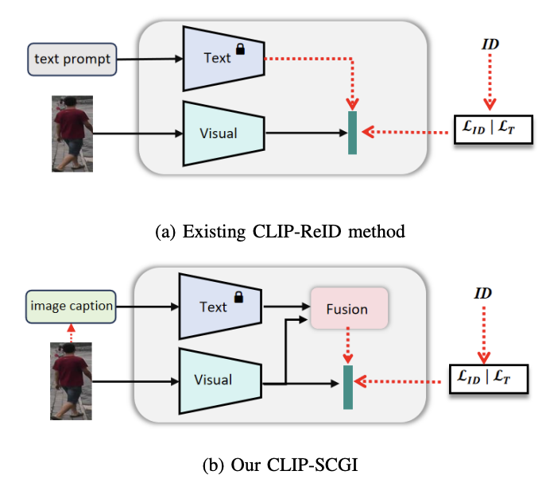
Recap – Literature Review on CLIP-SCGI
Problem: CLIP-ReID uses predefined ID tokens along with simple text prompts.
Absence of concrete descriptions that capture key semantic attributes such as gender, clothing, and age. Solution :
Leverage existing image captioning models(LLaVA) to generate pseudo captions for person images, to boost person re-identification using Vision language models (CLIP)
Introduce Caption guided inversion and Fusion module
CLIP-ReID
CLIP-SCGI
Notes:
One of recent CLIP based method (CLIP-SCGI) has shown using synthetic captions instead of static text to all the person ID.
CLIP-SCGI uses image captioner LLaVA (A large language vision model) to generate person specific captions.

Slide 7
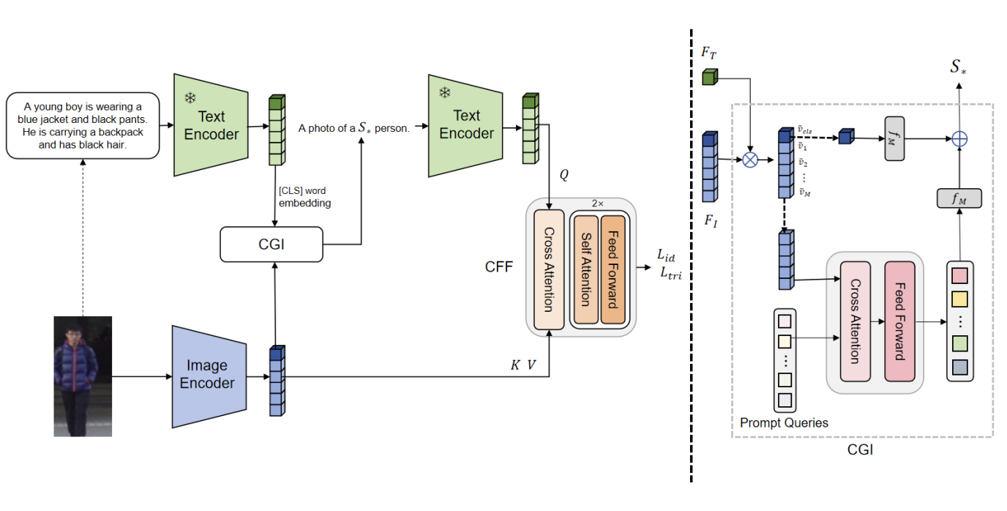
CLIP-SGCI :Methodology
On top of CLIP-ReID , CLIP-SCGI uses Caption Guided inversion(CGI) and Cross Feature Fusion(CFF) module
In Caption Guided Inversion , semantic attributes from images are converted into pseudo-word tokens guided through text descriptions.
Cross attention is performed between extracted features , guiding the model to focus on relevant regions.
The objective function remains same as CLIP-ReID (ID loss + Triplet loss + contrastive loss)

Slide 8
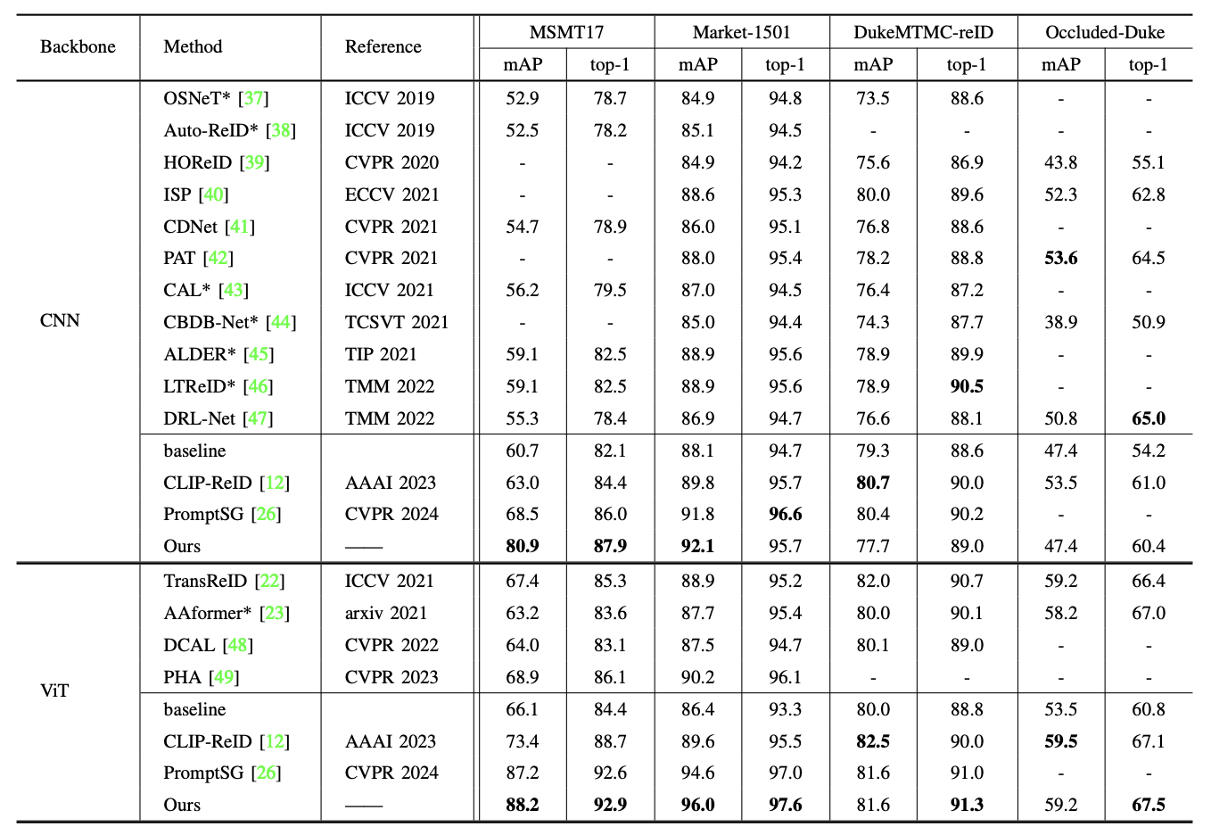
CLIP-SCGI – State-of-the-art Comparison
CLIP-SCGI has 26% higher parameters than CLIP-ReID
No increase in training time for one-stage approach compared to the two-stage CLIP-ReID.
Recap – Literature Review on CLIP-SCGI​

Slide 9
CLIP-SCGI
Challenges :
Open-source implementation is not available
Develop the modules from scratch which is time expensive.
Overhead of extracting synthetic captions using Large Language models.
Based on the observations from CLIP-ReID results , CLIP-SCGI can be considered for future work

Slide 10
Current Progress
Setup of CLIP-ReID codebase
Training of CLIP-ReID and OSNeT on :
Market-1501
Lowe's in-house ReID dataset
Qualitative and Quantitative comparison of CLIP-ReID and OSNeT on both datasets.
Resolved CLIP-ReID issues including model downloads and system dependencies(Turtle GUI)

Slide 11
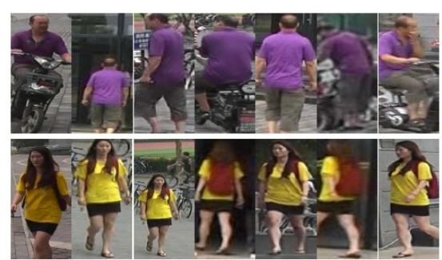
Dataset overview : Market-1501
A Large-scale public benchmark dataset for person re-identification tasks
This dataset consists of 1501 identities.
Split | IDs | Images | Cameras
Train | 751 | 12936 | 6
Query | 750 | 3368 | 6
Gallery | 751 | 15913 | 6
Test set
Dataset statistics
Each identity is present in atleast 2 cameras

Slide 12
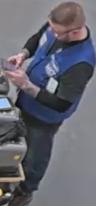
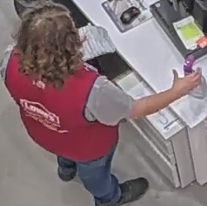
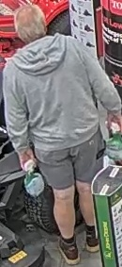
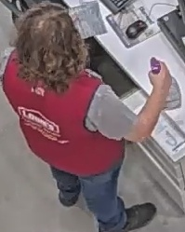
Dataset overview : Lowe's Re-ID Data
Train set examples
This dataset consists of 1022 identities.
Split | IDs | Images | Cameras
Train | 688 | 13615 | 1
Query | 466 | 3612 | 1
Gallery | 680 | 13625 | 1
Test set examples​
Test set
Dataset statistics
Each identity is across only one camera.

Slide 13
Experiments : Re-ID Evaluation workflow
Extract features for all the query and gallery images.
Apply L2 Normalization to feature vector.
Compute Euclidean distance between query and gallery features.
Generate a distance matrix ; Rank gallery images in ascending order.
Evalutation metrics :
CMC curve Assess matching probability at various ranks(Rank-1 Accuracy)
Mean Average Precision measures the retrival performance
Key : For each query identity, its gallery images from the same camera view are discarded

Slide 14
Experiments : Quantitative Results
Performance comparison of CLIP-ReID & OSNeT on Market-1501 Dataset
Method | Epochs | mAP | Top-1 Accuracy
OSNeT | 60 | 78.3 | 93.8%
OSNeT | 250 | 85.3% | 93.8%
CLIP-ReID | 60 | 89.8% | 95.3%
CLIP-ReID+SIE+OLP | 60 | 96.6% | 99.9%
13.2% mAP ,
6.5% Top-1 Accuracy

Slide 15
Experiments: Quantitative Results
Performance comparison of CLIP-ReID & OSNeT on Lowe's Dataset ​
Method | Epochs | mAP | Top-1 Accuracy
OSNET | 50 | 95.8% | 98.3%
CLIP-ReID | 60 | 96.6% | 98.3%
CLIP-ReID+SIE+OLP | 60 | 96.6% | 98.2%
Both methods perform in similar for the below reasons :
Unlike Market-1501 , Lowe's data has common identities in both train and test split.
This dataset lacks multi camera and multi view samples.
In Traditional ReID evaluations , Gallery samples from same person and camera are not considered. However , we evaluate on same samples.

Slide 16







Lowe's Data : Query & Gallery Examples
Query:
Train samples :
Train set and Test set has Similar Identities
No Multi camera samples
Gallery:
As the Query is similar to Gallery images , their Feature Norms are closer and Hence, Always Rank as Top-1.

Slide 17






Market –1501 Dataset : Query & Gallery Examples
Query:
Train spilt does not contain this sample
Cross Camera sample between Query and Gallery samples
​
Gallery:

Slide 18
CLIP-ReID– Takeaways
Quantitative results on Market-1501 suggest that CLIP-ReID is better than OSNeT.
CLIP-ReID requires less training than OSNeT(in terms of epochs) due to CLIP's pretraining.
Unlike to this trend , performance on Lowe's data is almost similar due to below limitations. So irrespective of the method , unless the dataset is diverse the performance remains same.
Limitations :
Query and Gallery images belong to same camera
Train and Test split has common images.
Lack of multi camera image samples.

Slide 19
Conclusion
Goal : To Enhance person re-identification task of Multi camera tracking framework.
Explored state-of-the-art person Re-ID methods CLIP-ReID , CLIP-SCGI
Conducted experiments on Market-1501, Lowe's datasets using CLIP-ReID, OSNeT.
CLIP-ReID outperforms OSNeT(our baseline) by 13.2% , 6% in mAP , rank-1 accuracy respectively on Market-1501.
In Contrast to Market-1501 data, both approaches demonstrate similar performance on Lowe's data due to several dataset limitations.

Slide 20
Next Steps
​
Evaluate CLIP-ReID on Lowe's data which contains multi camera data.
Extract CLIP-ReID features and replace them with OSNeT features in existing Multi camera tracking pipeline
Perform end-to-end tracking after replacing CLIP-ReID component.
Conduct literature study :
Multi camera tracking approach BEV-SUSHI: Multi-Target Multi-Camera 3D Detection and Tracking in Bird’s-Eye View from Nvidia
Generate multi-view human data to enhance training using Pippo: High-Resolution Multi-View Humans from a Single Image
​

Slide 22
Multi Camera Tracking Project
Spring 2025 – weekly progress - Feb 27

Slide 23
Agenda
Objective
Recap
Current progress
Experimental Discussion (CLIP-ReID, OSNeT)
Literature study on Pippo
Conclusion
Next steps

Slide 24
Objective
Project Goal : Developing a robust foundational Mutli camera tracking model , with a focus on person re-identification(Re-ID) tasks for this semester.

Slide 25
Recap
Discussed state-of-the-art person re-identification approaches like CLIP-ReID,CLIP-SCGI
Setup CLIP-ReID codebase and resolved issues (Turtle GUI and model downloads).
Training of CLIP-ReID and OSNeT on :
Market-1501
Lowe's in-house ReID dataset
Qualitative and Quantitative comparison of CLIP-ReID and OSNeT on both datasets.

Slide 26
Experiments : Quantitative Results
Market-1501 Dataset
Lowe's Dataset ​
Method | Epochs | mAP | Top-1 Accuracy
OSNeT | 60 | 78.3 | 93.8%
OSNeT | 250 | 85.3% | 93.8%
CLIP-ReID | 60 | 89.8% | 95.3%
CLIP-ReID+SIE+OLP | 60 | 96.6% | 99.9%
Method | Epochs | mAP | Top-1 Accuracy
OSNET | 50 | 95.8% | 98.3%
CLIP-ReID | 60 | 96.6% | 98.3%
CLIP-ReID+SIE+OLP | 60 | 96.6% | 98.2%
13.2% mAP ,
6.5% Top-1 Accuracy
No change observed in the metrics. Due to Dataset limitations

Slide 27
Lowe's Data Overview & Limitations
Query:
Train samples :
Train set and Test set has Similar Identities
No Multi camera samples
Gallery:
As the Query is similar to Gallery images , their Feature Norms are closer and Hence, Always Rank as Top-1.

Slide 28
Market –1501 Dataset : Query & Gallery Examples
Query:
Train spilt does not contain this sample
Cross Camera sample between Query and Gallery samples
​
Gallery:

Slide 29
Current Progress
To better understand the effectiveness of CLIP-ReID and OSNeT, we performed cross-setting experiments.
Quantitative analysis of cross-setting evaluations for both .
Conducted literature study on generating multi-view synthetic data.
Familiarized with Pippo ,latest multi-view video generation model from single human image as input.

Slide 30
Cross setting Evaluation
Trained on Market-1501 Train split and evaluated on Lowe's Data(Test Split)
Method | Epochs | mAP | Top-1 Accuracy
OSNeT | 50 | 68.4 | 96.2%
OSNeT | 150 | 70.2 | 96.7%
CLIP-ReID | 60 | 80.4 | 96.7%
CLIP-ReID+SIE+OLP | 60 | 80.7 | 96.7%
CLIP-ReID outperforms OSNet in mAP, suggesting better retrival performance and better feature discrimination.
OSNeT struggles with domain shift, the learned features may be dataset specific.
Notes:
HIgher maP means More precise retrival of correct matches across frame in multi-camera tracking.

Slide 31
CLIP-ReID or OSNeT
CLIP-ReID leverages a richer embedding space that captures more semantic person information beyond low level CNN features.
This might help in cases where a person's appearance changes due to lighting , pose or occlusion
Better ReID features benefits tracking , More precise retrieval of correct matches across frames in multi camera tracking.
More discriminative features mean fewer ID switches in tracking algorithms.
In Conclusion , CLIP-ReID's stronger generalization across domains, robust person re-identification features would improve tracking performance.
Hence, these observations suggest CLIP-ReID is better than OSNeT
Notes:
HIgher maP means More precise retrival of correct matches across frame in multi-camera tracking.

Slide 32
Pippo: High-Resolution Multi-View Humans from a Single Image
Authors: Yash Kant, Ethan Weber, Jin Kyu Kim , Rawal Khirodkar , Su Zhaoen, Julieta Martinez , Igor Gilitschenski ,
Shunsuke Saito , Timur Bagautdino
Source : pippo.pdf

Slide 33
Pippo – Problem & Motivation
Challenges in Multi-View Human Generation
Creating a realistic multi-view images is difficult.
Existing approaches rely on expensive 3D captures or predefined models.
Pippo's introduction
Uses a data-driven approach to synthesize consistent multi-view images.
Requires only a single image without parametric models.

Slide 34
Pippo – Background and Related work
Multi-View Human Generation
Traditional methods use parameteric 3D models like SMPL or explicit mesh reconstruction.
Neural rendering approaches, such as NeRF, struggle with limited input data. ​
Diffusion Transformer
Recent works use diffusion models for image synthesis but lack structured multi-view consistency.
Pippo introduces spatial conditioning and large-scale training for high-resolution multi-view generation. ​

Slide 35
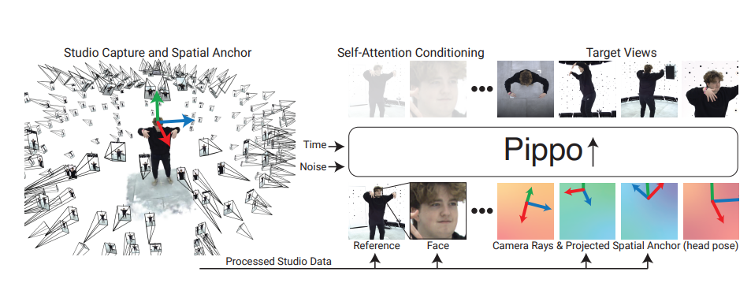
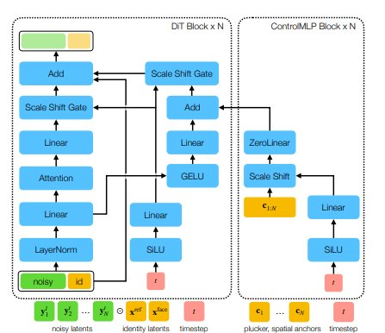
Pippo – Pipeline overview

Slide 36
Pippo's Approach
Multi stage Training pipeline
Pre-training : Learns generalizable features from 3B in the wild human images.
Mid-training :
Learns multi-view generation from studio-captured datasets.
Train model at low-resolution of 128 × 128 to denoise 48 target views with coarse camera control (no pixel-aligned spatial control).
Post-training:
Enhances 3D consistency using Spatial Anchor & plucker rays.
Train at a high-resolution of 1024 × 1024 to denoise 1 − 3 target views with spatial control injected via ControlMLP layers
Diffusion Transformer(DiT) Model:
Generates multiple views simultaneously with high fidelity

Slide 37
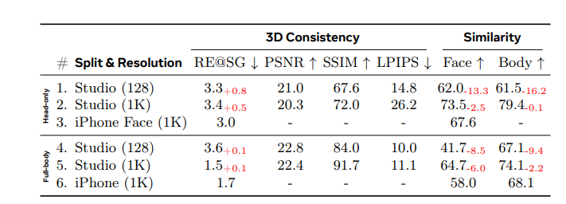
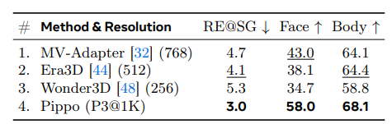
Pippo – Experimental results
Training Data : Humans-3B , High quality head and full body
Test Data : Real world images from iphone.
Evaluation metrics :
3D Consistency like reprojection error(RE@SG) , PSNR , SSIM , LPIPS
Identity evaluation using cosine similarity of features from FaceNet for face , CLIP features for body
State-of-the-art-comparison
Unseen studio and iphone data

Slide 38
Qualitative examples of Pippo

Slide 39
Conclusion
Goal : To Enhance person re-identification task of Multi camera tracking framework.
Conducted experiments on Market-1501, Lowe's datasets using CLIP-ReID, OSNeT.
From initial observations , both approaches demonstrate similar performance on Lowe's data due to several dataset limitations.
Based on the cross setting evaluations, it is evident that CLIP-ReID is better than OSNeT.
With the focus of improving training data, we can leverage pippo capabilities to generate multi-view turnaround videos.

Slide 40
Next Steps
​
Evaluate CLIP-ReID on Lowe's data which contains multi camera data(New Dataset).
Extract CLIP-ReID features and replace them with OSNeT features in existing Multi camera tracking pipeline
Perform end-to-end tracking after replacing CLIP-ReID component.
Utilize Pippo which generates multi-view human turn around synthetic video to enhance ReID task and further tracking.
​

